Slide 1

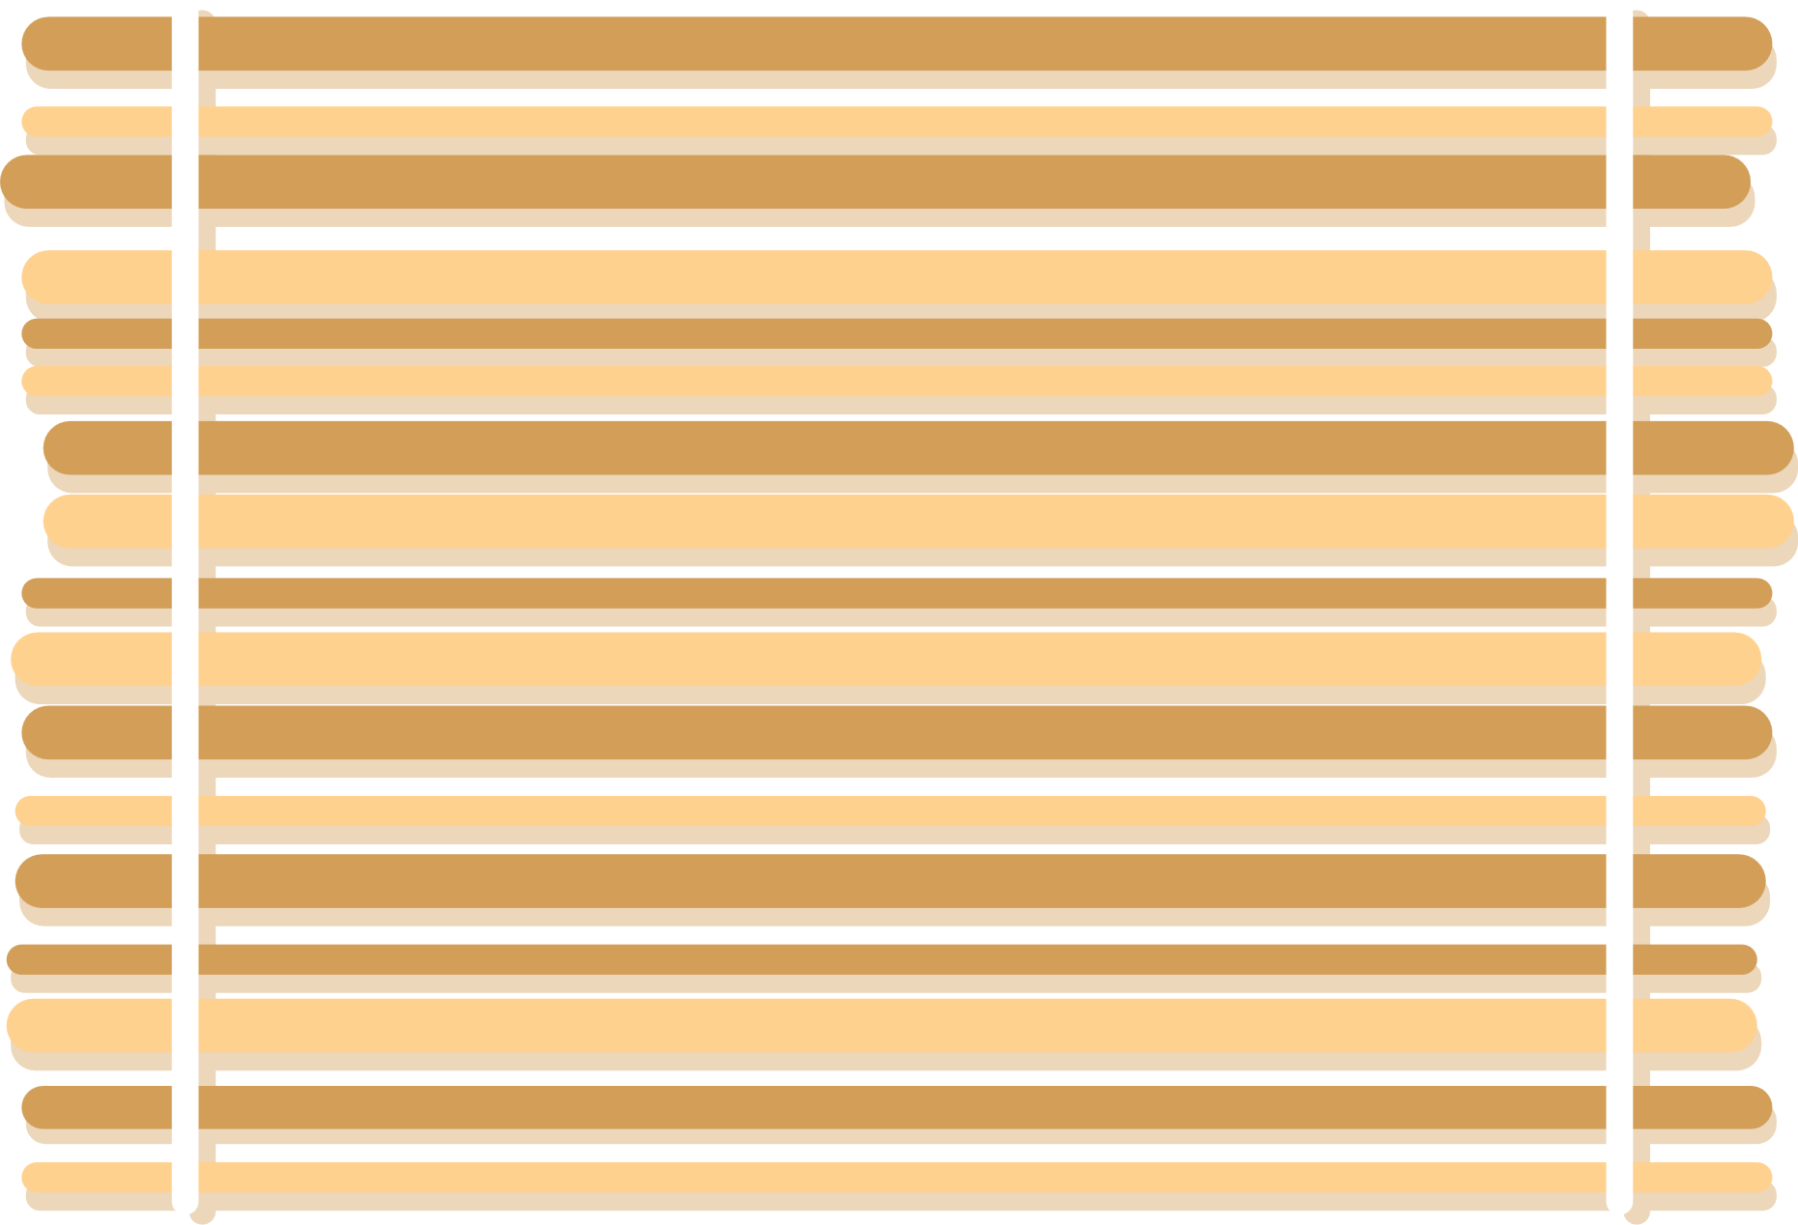






TABLE
TALES
GROUP MEMBERS
ZAHRA U24CS011
EMIL U24CS012
BHUMI U24CS048
KHUSHI U24CS066

Slide 2






AIM
To build a cool website that delivers food fast, fill bellies and help survive
the lazy days becausee
WHY COOK?? WHEN U CAN CLICK !! .

Slide 3
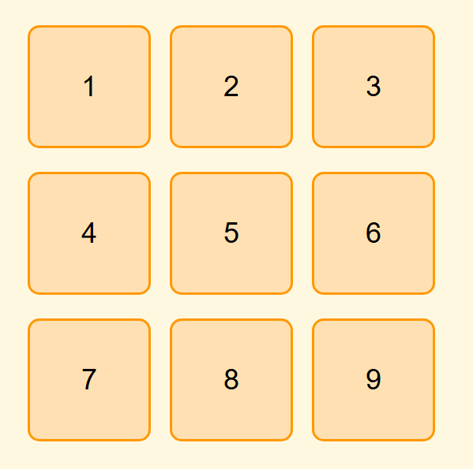
UNIQUE
Checkout
PAGE
Our project redefines the traditional checkout experience by blending functionality with fun. Instead of ending the transaction with a dull invoice, we surprise users with an interactive PICK THE BOX’ feature that unlocks exciting offers like free drinks, discounts, or vouchers. This gamified twist not only enhances user engagement but also encourages repeat visits and brand loyalty. By integrating real-world billing elements like GST and service tax with playful UI design, we've transformed a routine process into a rewarding experience — because why should invoices be boring when they can be brilliant?

Slide 4


CONCLUSION
Our online food ordering website isn't just a digital menu — it's a complete experience that combines ease, efficiency, and excitement. From a clean checkout process to interactive features like the Spin the Wheel, we've built a platform that not only satisfies hunger but also delights users. With a focus on user engagement, real-world utility, and smart design, this project demonstrates how technology can transform even the simplest tasks into something memorable. It's not just about ordering food — it’s about enjoying every click along the way.

Slide 5
THANK YOU FOR YOUR ATTENTION

